Slide 1
ANOVA TESTING - ANALYSIS OF VARIABLE
IT IS ONE WAY CLASSIFICATION
WHEN THERE ARE THREE OR MORE GROUPS WITHOUT REPEATED VALUES, WE WILL DO ANOVA TESTING

Slide 2
EX:- TO TEST THE SIGNIFICANCE OF THE VARIATION
OF THE RETAIL PRICES OF A COMMODITY IN 3 CITIES, FOUR
SHOPS WERE CHOOSEN AT RANDOM IN EACH CITY AND
PRICES OBSERVED IN RUPEES WERE FOUND AS FOLLOWS
 |  | SHOPS
CITIES | BOMBAY(x1) | 16 | 8 | 12 | 14
 | DELHI (x2) | 14 | 10 | 10 | 16
 | GOA (x3) | 4 | 10 | 8 | 8
TO THE DATA INDICATE THAT THE PRICES IN 3 CITIES ARE SIGNIFICANTLY OR NOT AT 5%

Slide 3
Null Hypothesis(H₀) =It says that There is no significant difference between the prices in 3 cities
Alternative Hypothesis(H_{a}) =It says that There is no significant difference between the prices in 3 cities
Level of Significance(α) = 5%
CALCULATIONS:-
Grand Total (G) = Total of all Prices
G = 16+8+12+14+14+10+10+16+4+10+8+8
G=130
No. of Observations(n)=12
Correction Factor(CF) = (G)²/n
CF= (130)²/12=16900/12=1408.33
CF=1408.33

Slide 4
Sum of Square of Total (SST) = (16)²+(8)²+(12)²+(14)²+(14)²+(10)²+(10)²+(16)²+(4)²+(10)²+(8)²+(8)² - CV
SST = 1556-1408.3
SST=147.7
Sum of Square of Cities(SSC) = [ε((x1)² /n1+ ε((x2)² /n2+ ε((x3)² /n3] - CV
SSC =[(50)² /4+(50)² /4+(30)² /4]-1408.3
SSC=[2500/4+2500/4+900/4]-1408.3
SSC=(625+625+225)-1408.3
SSC=1475-1408.3
SSC=66.7
Sum of Square of Errors(SSE) = SST-SSC
SSE=147.7-66.7
SSE=81
Degree of Freedom for Total = n-1 = 12-1 =11
Degree of Freedom for Cities = n-1=3-1=2
Degree of Freedom for Errors = Degree of Freedom for Total –
Degree of Freedom for Cities = 11-2 =9
Degree of Freedom for Errors = 9

Slide 5
ANOVA TABLE (OR) ANALYSIS
SOURCE | DEGREE OF FREEDOM | SUM OF SQUARE | MEAN SUM OF SQUARES (SUM OF SQUARE/DEGREE OF FREEDOM
CITIES | 2 | 66.7 | 66.7/2=33.35
ERRORS | 9 | 81 | 81/9=9
TOTAL | 11 | 147.7 | 147.7/11=13.43
F= Mean sum of Square of Cities/Mean sum of Square of Errors
F=33.35/9 = 3.70
F(Calculate Value) = 3.70
Level of Significance(α) = 5%
We can choose two Degree of Freedom Values V1 and V2
Here V1= DOF of Cities & V2 = DOF of Errors
V1= 2 & V2=9

Slide 6
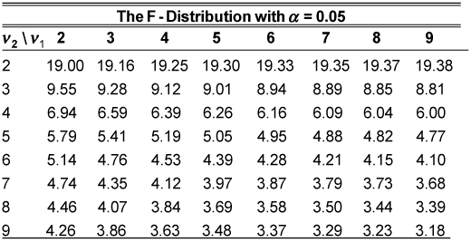
F value from F-table Value = 4.26
Compare F – Calculate Value and F-table Value
3.70<4.26
Conclusion – Calculate Value is less than table value then we accept null hypothesis as 5% level of significance and we conclude that there is no significant difference between the prices in 3 cities.

